Slide 1
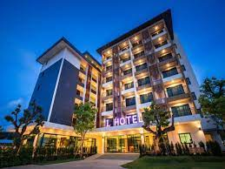
SYSTEM RESERVATION HOTEL
DR.RANDA

Slide 2
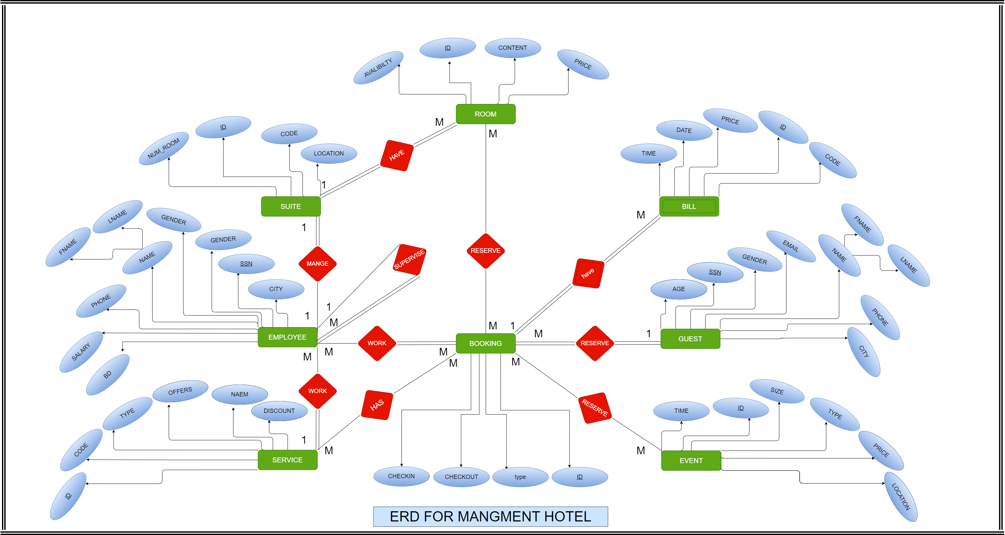

Slide 3
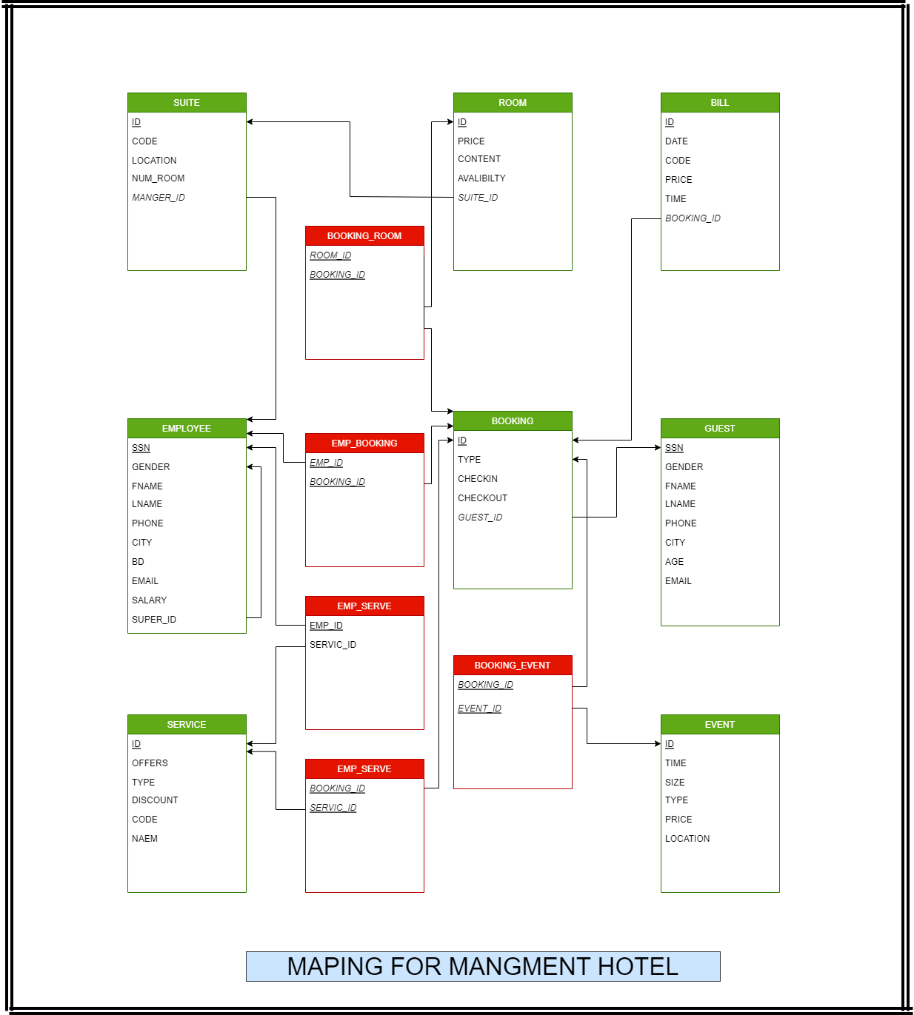

Slide 4
THANK YOU

